Slide 1



SAPTHAGIRI COLLEGE OF ENGINEERING (Affiliated to Visvesvaraya Technological University, Belagavi & Approved by AICTE, New Dehli) Department of Computer Science & Engineering
Presentation on :- Presented By:-
Fake Job Prediction Swapnil 1SG18CS119
Using Machine Learning Pranav Parth 1SG18CS072
Rishu Raj 1SG18CS085
Ritik Saini 1SG18CS086
Under the Guidance of:
Prof. Latha A
Assistant Professor,
Dept. Of CSE, SCE
2021-22

Slide 2
Contents
Absract
1
2
Introduction
Problem Statement
3
4
Software Requirements
Architecture
5
6
Proposed System
7
NLP
8
Naïve Bayes
SGD
9

Slide 3
ABSTRACT
To design a qualified training program so that the competence of job seekers can be in line with the industrial needs, Training Need Analysis (TNA) should be conducted before establish a training program. But unfortunately there have been many fraudulent job ads by individuals on behalf of the company. In order to overcome the problem, an employment scam detection is required. Different classifiers are used for checking fraudulent post in the web and the results of those classifiers are compared for identifying the best employment scam detection model.

Slide 4
Introduction
Employment scams are on the rise. According to CNBC, the number of employment scams doubled in 2018 as compared to 2017. The current market situation has led to high unemployment. Economic stress and the impact of the coronavirus have significantly reduced job availability and the loss of jobs for many individuals. A case like this presents an appropriate opportunity for scammers. Many people are falling prey to these scammers using the desperation that is caused by an unprecedented incident. Most scammer do this to get personal information from the person they are scamming. Personal information can contain address, bank account details, social security number etc. I am a university student, and I have received several such scam emails. The scammers provide users with a very lucrative job opportunity and later ask for money in return. Or they require investment from the job seeker with the promise of a job. This is a dangerous problem that can be addressed through Machine Learning techniques and Natural Language Processing (NLP).

Slide 5

Problem Statement
This project aims to create classifier that will have the capability to identify fake and real jobs.
The final result will be evaluated based on two different models. Since the data provided has both numeric and text features one model will be used on the text data and other on numeric data.
The final output will be a combination of the two. The final model will take in any relevant job posting and produce a final result determining whether the job is real or not

Slide 6
Software Requirements
2 GB RAM
Microsoft Windows: 7/8/10
Dual Core Processor
Python: 3.6+
Hard Disk: 128 GB
Modem(Wi-Fi/Ethernet)
Jupyter Notebook
I/O Devices
Hardware Requirements
Software
Requirements

Slide 7
Architecture
Problem Definition
Evaluation
Data Collection
Modelling
Data Exploration & Visualisation
Data Pre-Processing/ Mining

Slide 8
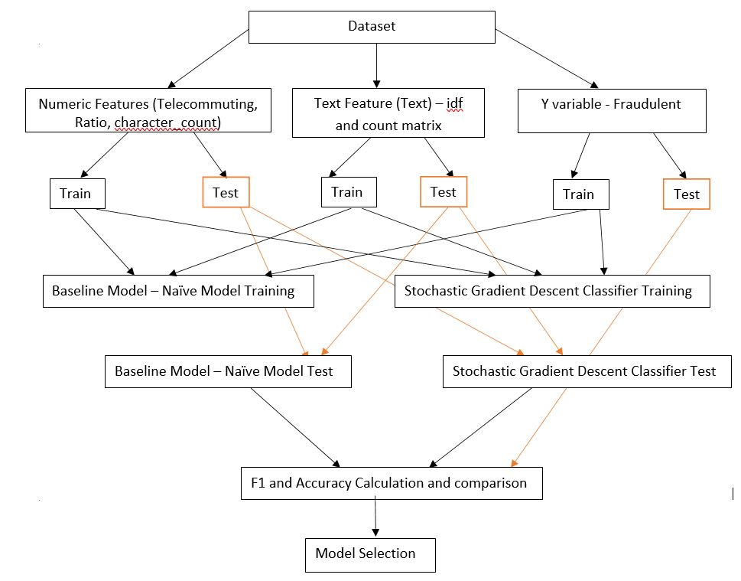
Proposed System

Slide 9
Natural Language Processing
The essence of NLP lies in making computer understand the natural language.
Computers can understand the structured form of data like spreadsheets and the tables , but human languages, texts, and it gets difficult for the computer to understand it, and there arises the need for NLP.
Computers can’t truly understand the human language. If we feed enough data and train a model properly, it can distinguish and try categorizing various parts of speech based on previously fed data and experiences.

Slide 10
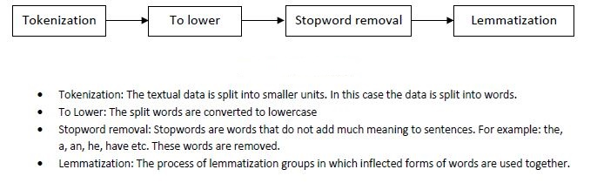
Stages of performing NLP

Slide 11
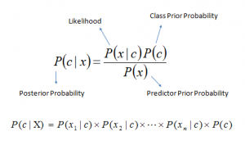
Naïve Bayes
Naïve Bayes is used because it can compute the conditional probabilities of occurrence of two events based on the probabilities of occurrence of each individual event, encoding those probabilities is extremely useful.

Slide 12
Stochastic Gradient Descent
The word ‘stochastic‘ means a system or a process that is linked with a random probability. In SGD, a few samples are selected randomly instead of the whole data set for each iteration.
The SGD Classifier is used since it implements a plain stochastic gradient descent learning routine which supports different loss functions and penalties for classification.
Different Loss Function / Metrics :
1. Accuracy
2. F1-score

Slide 13
THANK YOU !

